Slide 1
Measuring a
Nation’s Income
CHAPTER
5

Slide 2
Economics
Microeconomics
  Study of how households and firms
    Make decisions
    Interact in markets
Macroeconomics
  Study of economy-wide phenomena
    Including inflation, unemployment, and economic growth

Slide 3
Economy’s Income & Expenditure
Gross Domestic Product (GDP)
  Measures the total income of everyone in the economy
  Measures the total expenditure on the economy’s output of goods and services
For an economy as a whole
  Income must equal expenditure

Slide 4
Economy’s Income & Expenditure
Circular-flow diagram – assumptions:
  Markets
    Goods and services
    Factors of production
  Households
    Spend all of their income
    Buy all goods and services
  Firms
    Pay wages, rent, profit to resource owners

Slide 5
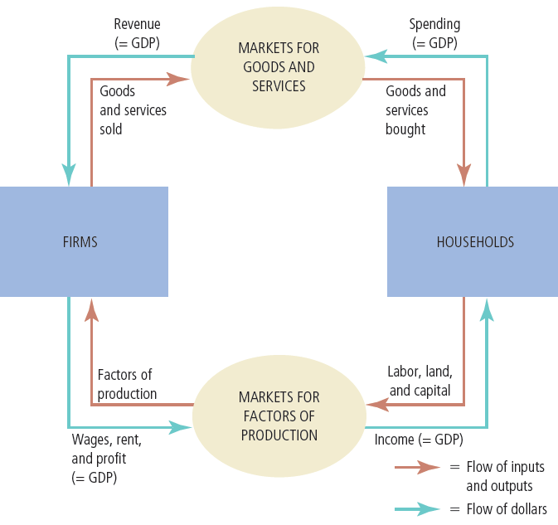
Figure 1 The Circular-Flow Diagram
Households buy goods and services from firms, and firms use their revenue from sales to pay wages to workers, rent to landowners, and profit to firm owners. GDP equals the total amount spent by households in the market for goods and services. It also equals the total wages, rent, and profit paid by firms in the markets for the factors of production.

Slide 6
The Measurement of GDP
Gross domestic product (GDP)
  Market value of all final goods and services
  Produced within a country
  In a given period of time
“GDP is the market value…”
  Market prices – reflect the value of the goods

Slide 7
The Measurement of GDP
“… of all…”
  All items produced in the economy
    And sold legally in markets
  Excludes most items
    Produced and sold illicitly
    Produced and consumed at home

Slide 8
The Measurement of GDP
“… final…”
  Value of intermediate goods is already included in the prices of the final goods
“… goods and services…”
  Tangible goods & intangible services
“… produced…”
  Goods and services currently produced

Slide 9
The Measurement of GDP
“… within a country…”
  Goods and services produced domestically
    Regardless of the nationality of the producer
“… in a given period of time”
  A year or a quarter

Slide 10
The Components of GDP
Identity: Y = C + I + G + NX
  Y = GDP
  C = consumption
  I = investment
  G = government purchases
  NX = net exports

Slide 11
The Components of GDP
Consumption, C
  Spending by households on goods and services
    Goods: durable goods, nondurable goods
    Services: intangibles, spending on education
  Exception: purchases of new housing

Slide 12
The Components of GDP
Investment, I
  Purchase of (capital) goods that will be used to produce other goods and services in the future
    Business capital: business structures, equipment, and intellectual property products
    Residential capital: landlord’s apartment building; a homeowner’s personal residence
    Inventory accumulation

Slide 13
The Components of GDP
Government purchases, G
  Government consumption expenditure and gross investment
  Spending on goods and services
  By local, state, and federal governments
  Does not include transfer payments

Slide 14
The Components of GDP
Net exports, NX = Exports - Imports
  Exports
    Spending on domestically produced goods by foreigners
  Imports
    Spending on foreign goods by domestic residents

Slide 15
The components of U.S. GDP
2015, GDP of the U.S.: almost $18 trillion
GDP per person = $55,822
  Consumption = $38,218 per person
    68% of GDP
  Investment = $9,402 per person
  Government purchases = $9,919 per person
  Net exports = - $1,657 per person
    Americans spent more on foreign goods than foreigners spent on American goods

Slide 16
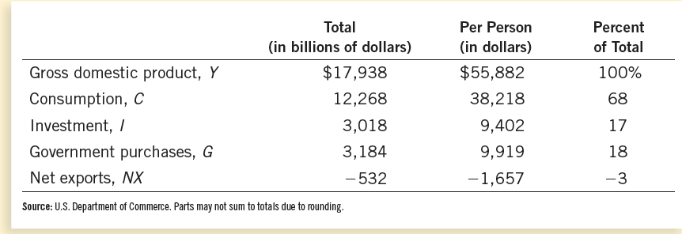
Table 1 GDP and Its Components
This table shows total GDP for the U.S. economy in 2015 and the breakdown of GDP among its four components. When reading this table, recall the identity
Y = C + I + G + NX.

Slide 17
Real versus Nominal GDP
Total spending rises from one year to the next
  Economy — producing a larger output of goods and services
  And/or goods and services are being sold at higher prices
Nominal GDP
  Production of goods and services
  Valued at current prices

Slide 18
Real versus Nominal GDP
Real GDP
  Production of goods and services
  Valued at constant prices
  Designate one year as base year
  Not affected by changes in prices
For the base year
  Nominal GDP = Real GDP

Slide 19
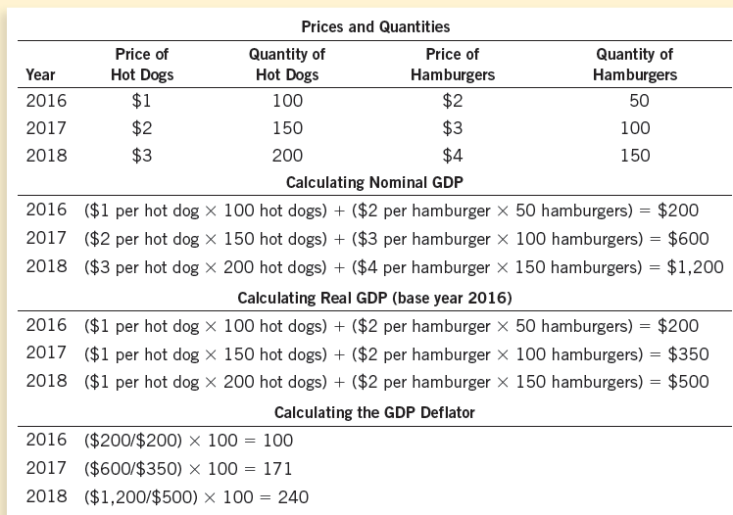
Table 2 Real and Nominal GDP
This table shows how to calculate real GDP, nominal GDP, and the GDP deflator for a hypothetical economy that produces only hot dogs and hamburgers.

Slide 20
Real versus Nominal GDP
The GDP deflator
  Ratio of nominal GDP to real GDP times 100
  Is 100 for the base year
  Measures the current level of prices relative to the level of prices in the base year
  Can be used to take inflation out of nominal GDP (“deflate” nominal GDP)

Slide 21
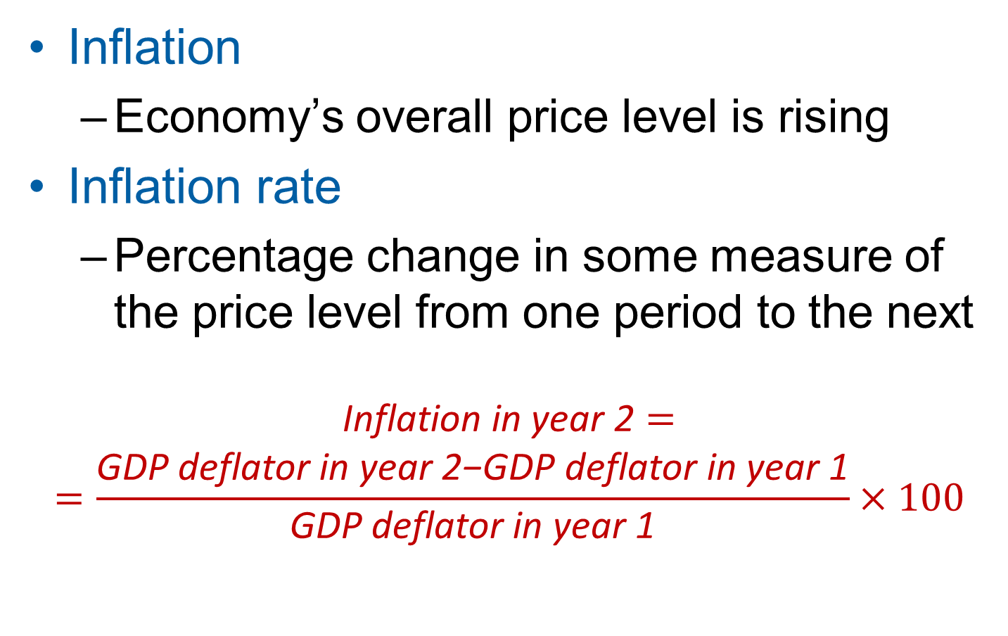
Real versus Nominal GDP
Inflation
  Economy’s overall price level is rising
Inflation rate
  Percentage change in some measure of the price level from one period to the next
$$\begin{matrix}\text{Inflation} \text{in} \text{year}\text{ 2}= \\ =\frac{\text{GDP} \text{deflator} \text{in} \text{year}\text{ 2−}\text{GDP} \text{deflator} \text{in} \text{year}\text{ 1}}{\text{GDP} \text{deflator} \text{in} \text{year}\text{ 1}}×100\end{matrix}$$

Slide 22
A half century of real GDP
The GDP data
  Real GDP grows over time
    The real GDP of the U.S. economy in 2015 was more than four times its 1965 level
    Growth – average 3% per year since 1965
  Growth is not steady
    GDP growth interrupted by recessions

Slide 23
A half century of real GDP
Recession
  Two consecutive quarters of falling GDP
  Real GDP declines
  Lower income
  Rising unemployment
  Falling profits
  Increased bankruptcies

Slide 24
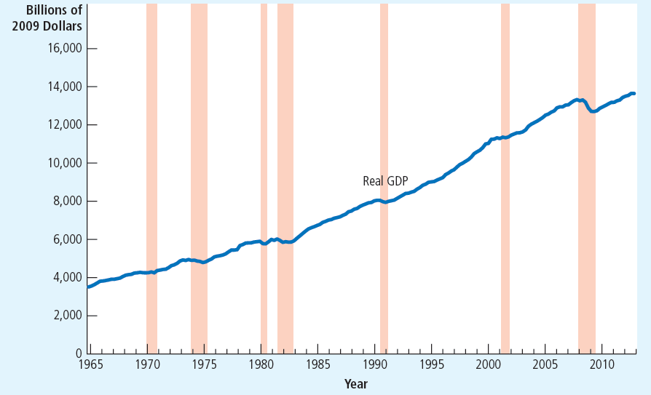
Figure 2 Real GDP in the United States
This figure shows quarterly data on real GDP for the U.S. economy since 1965. Recessions—
periods of falling real GDP—are marked with the shaded vertical bars.

Slide 25
GDP
GDP – “the single best measure of the economic well-being of a society”
  Economy’s total income
  Economy’s total expenditure
  Larger GDP
    Good life, better healthcare
    Better educational systems
  Measure our ability to obtain many of the inputs into a worthwhile life

Slide 26
GDP
GDP – not a perfect measure of well-being
  Doesn’t include
    Leisure
    Value of almost all activity that takes place outside markets
    Quality of the environment
  Nothing about distribution of income

Slide 27
International differences: GDP & quality of life
Rich countries — higher GDP per person
  Better
    Life expectancy
    Literacy
    Internet usage
Poor countries — lower GDP per person
  Worse
    Life expectancy
    Literacy
    Internet usage

Slide 28
International differences: GDP & quality of life
Low GDP per person
  More infants with low birth weight
  Higher rates of infant mortality
  Higher rates of maternal mortality
  Higher rates of child malnutrition
  Less common access to safe drinking water
  Fewer school-age children are actually in school

Slide 29
International differences: GDP & quality of life
Low GDP per person
  Fewer teachers per student
  Fewer televisions
  Fewer telephones
  Fewer paved roads
  Fewer households with electricity

Slide 30
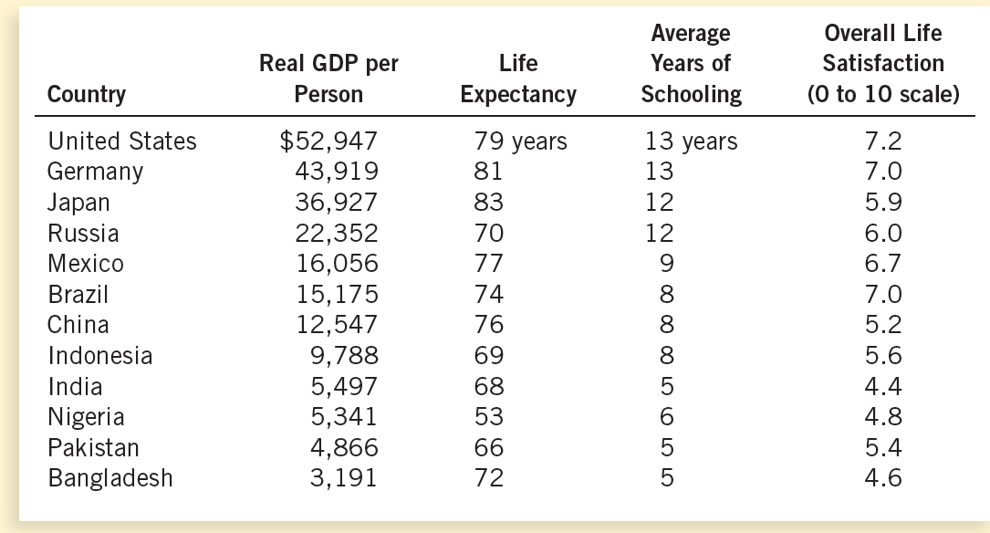
Table 3 GDP and the Quality of Life
The table shows GDP per person and three other measures of the quality of life for twelve major countries.

