Slide 1
Measuring the
Cost of Living
CHAPTER
6

Slide 2
The Consumer Price Index
Consumer price index (CPI)
  Measure of the overall level of prices
  Measure of the overall cost of goods and services
    Bought by a typical consumer
  Computed and reported every month by the Bureau of Labor Statistics

Slide 3
Calculating CPI
Fix the basket
  Which prices are most important to the typical consumer
  Different weight
Find the prices
  At each point in time
Compute the basket’s cost
  Same basket of goods
  Isolate the effects of price changes

Slide 4
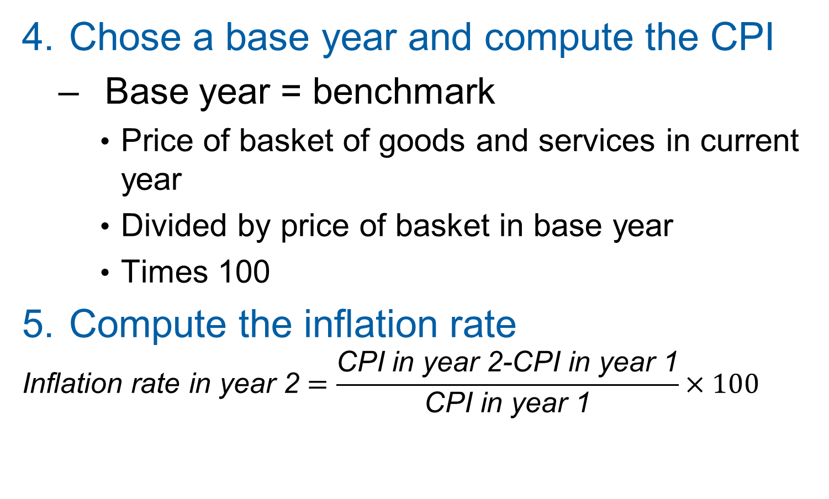
Calculating CPI
Chose a base year and compute the CPI
  Base year = benchmark
    Price of basket of goods and services in current year
    Divided by price of basket in base year
    Times 100
Compute the inflation rate
$$\text{Inflation} \text{rate} \text{in} \text{year}\text{ 2}=\frac{\text{CPI} \text{in} \text{year}\text{ 2−}\text{CPI} \text{in} \text{year}\text{ 1}}{\text{CPI} \text{in} \text{year}\text{ 1}}×100$$

Slide 5
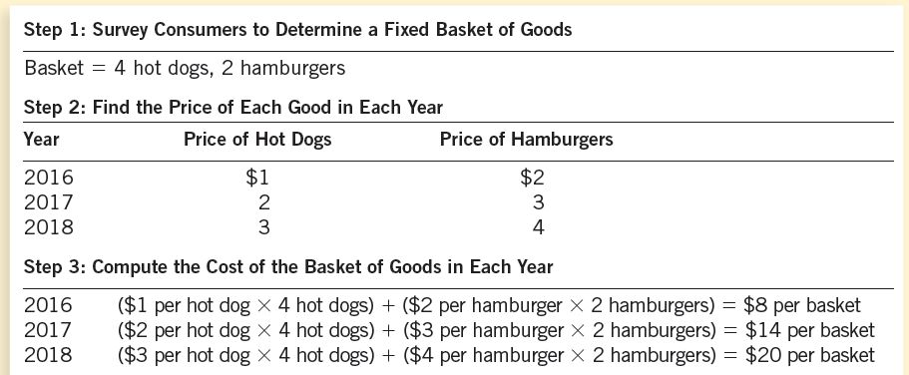
Table 1 Calculating the Consumer Price Index and the Inflation Rate: An Example
This table shows how to calculate the CPI and the inflation rate for a hypothetical economy in which consumers buy only hot dogs and hamburgers.

Slide 6
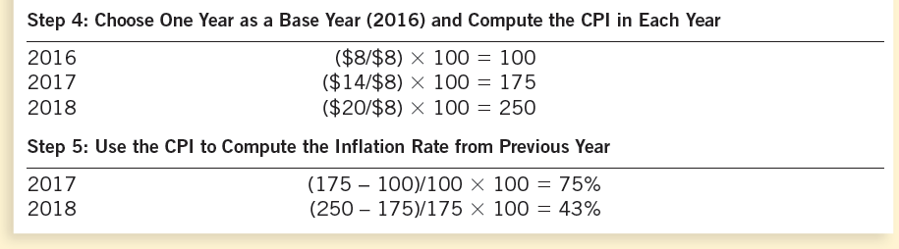
Table 1 Calculating the Consumer Price Index and the Inflation Rate: An Example
This table shows how to calculate the CPI and the inflation rate for a hypothetical economy in which consumers buy only hot dogs and hamburgers.

Slide 7
The Consumer Price Index
Inflation rate
  Percentage change in the price index
    From the preceding period
Core CPI
  Measure of the overall cost of consumer goods and services excluding food and energy

Slide 8
The Consumer Price Index
Producer price index, PPI
  Measure of the cost of a basket of goods and services bought by firms
  Changes in PPI are often thought to be useful in predicting changes in CPI

Slide 9
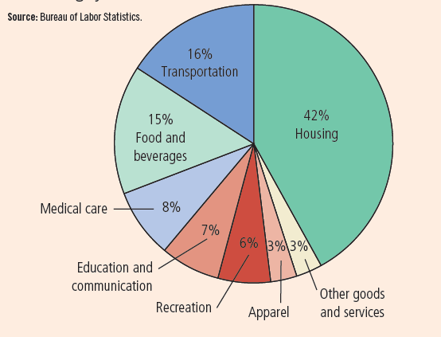
Figure 1 The Typical Basket of Goods and Services
This figure shows how the typical consumer divides spending among various categories of goods and services. The Bureau of Labor Statistics calls each percentage the “relative importance” of the category.

Slide 10
The Consumer Price Index
Problems in measuring the cost of living
  Substitution bias
    Prices do not change proportionately
    Consumers substitute toward goods that have become relatively less expensive
  Introduction of new goods
    More variety of goods
  Unmeasured quality change
    Changes in quality

Slide 11
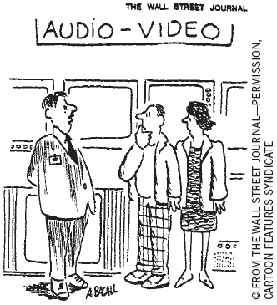
GDP deflator versus CPI
GDP deflator
  Ratio of nominal GDP to real GDP
  Reflects prices of all goods & services produced domestically
CPI
  Reflects prices of goods & services bought by consumers
“The price may seem a little high, but you have to remember that’s in today’s dollars.”

Slide 12
GDP deflator versus CPI
GDP deflator
  Compares the price of currently produced goods and services
    To the price of the same goods and services in the base year
CPI
  Compares price of a fixed basket of goods and services
    To the price of the basket in the base year

Slide 13
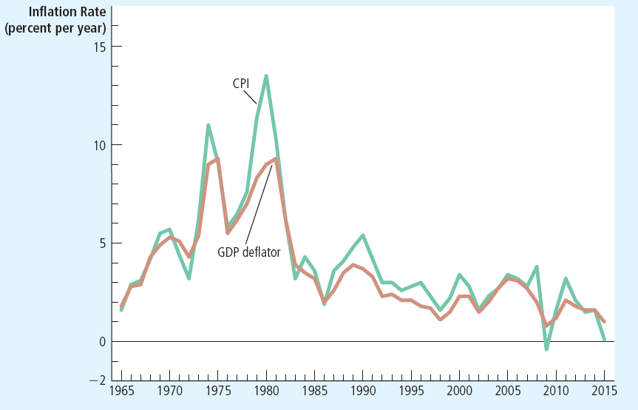
Figure 2 Two Measures of Inflation
This figure shows the inflation rate—the percentage change in the level of prices—as measured by the GDP deflator and the CPI using annual data since 1965. Notice that the two measures of inflation generally move together.

Slide 14
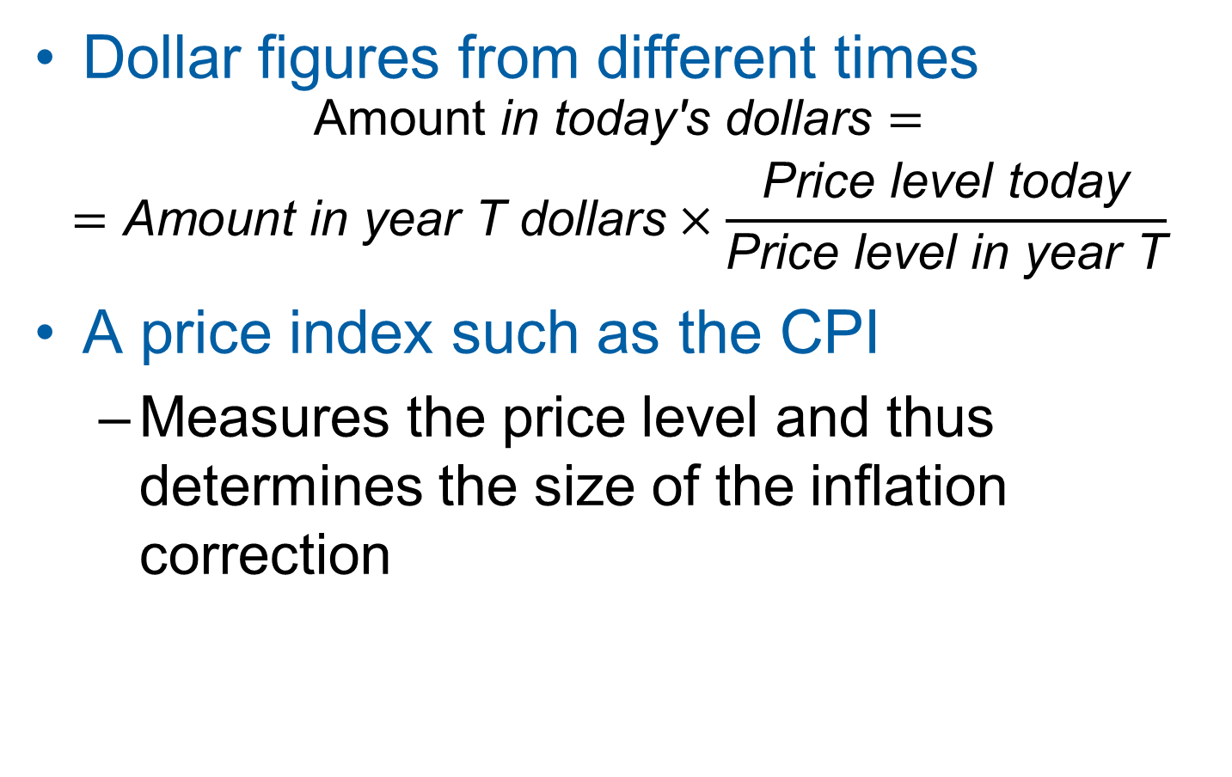
Correcting Economic Variables
Dollar figures from different times
$$\begin{matrix}\text{Amount} \text{in} \text{today}\text{′}\text{s} \text{dollars}= \\ =\text{Amount} \text{in} \text{year} \text{T} \text{dollars}×\frac{\text{Price} \text{level} \text{today}}{\text{Price} \text{level} \text{in} \text{year} \text{T}}\end{matrix}$$
A price index such as the CPI
  Measures the price level and thus determines the size of the inflation correction

Slide 15
Regional differences in the cost of living
The cost of living varies
  Not only over time
  But also over geography
Regional price parities
  Measure variation in the cost of living from state to state.

Slide 16
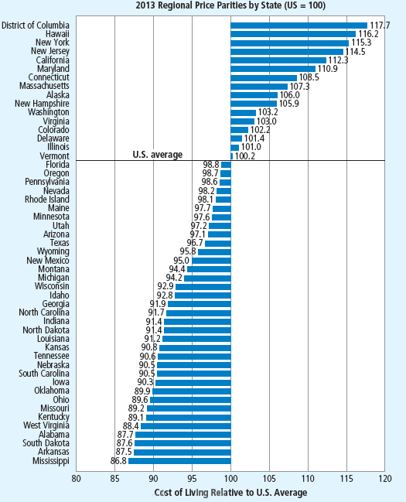
Figure 3 Regional Variation in the Cost of Living
This figure shows how the cost of living in the fifty U.S. states and the District of Columbia compares to the U.S. average.

Slide 17
Regional differences in the cost of living
Regional differences explained by
  Prices of goods – small part
  Prices of services – larger part
  Housing services – persistently large

Slide 18
Correcting Economic Variables
Indexation
  Automatic correction by law or contract
  Of a dollar amount
  For the effects of inflation
  COLA: Cost-of-living allowance

Slide 19
Real and Nominal Interest Rates
Nominal interest rate
  Interest rate as usually reported
  Without a correction for the effects of inflation
Real interest rate
  Interest rate corrected for the effects of inflation
= Nominal interest rate – Inflation rate

Slide 20
Interest rates in the U.S. economy
Nominal interest rate
  Always exceeds the real interest rate
  U.S. economy has experienced rising consumer prices in every year
Inflation is variable
  Real and nominal interest rates do not always move together
Periods of deflation
  Real interest rate exceeds the nominal interest rate

Slide 21
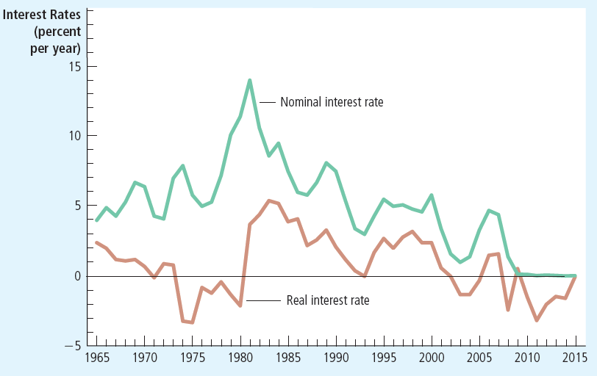
Figure 4 Real and Nominal Interest Rates
This figure shows nominal and real interest rates using annual data since 1965. The nominal interest rate is the rate on a three-month Treasury bill. The real interest rate is the nominal interest rate minus the inflation rate as measured by the CPI. Notice that nominal and real interest rates often do not move together.

